Slide 1
MULTI DISEASE PREDICTION USING MACHINELEARNING

Slide 2
Abstract
Many existing machine learning models for health care analysis focus on a single disease. For example, one analysis could be for diabetes, another for cancer, and another for skin problems.
There is no universal approach that can forecast multiple diseases using a single analysis. By utilising the Flask API, this project proposes a system that can forecast different diseases. Diabetes, heart disease, and breast cancer were all examined in this investigation.
In this project a system which used to predict multiple diseases by using Flask API.
In this project multiple disease prediction like heart disease, breast cancer, malaria, pneumonia, liver disease, diabetics, kidney diseases are predicted.
To implement multiple disease analysis used machine learning algorithms, TensorFlow and Flask API. Python pickling is used to save the model behavior and python unpickling is used to load the pickle file whenever required.

Slide 3
Introduction
During a lot of analysis over existing systems in health care analysis considered only one disease at a time
For example, article [1] is used to analyze diabetes, article [2] is used to analyze diabetes retinopathy, article [3] is used to predict heart disease [11]. Maximum articles focus on a particular disease. When any organization wants to analyze their patient’s health reports then they have to deploy many models. The approach in the existing system is useful to analyze only particular disease.
Now a day’s mortality got increased due to exactly not identifying exact disease. Even the patient got cured from one disease may be suffering from another disease

Slide 4
Existing System
Some existing systems used few parameters while analyzing the disease. Due to that may be not possible to identify the diseases which will be caused due to the effect of that disease. For example, due to diabetes, there may be chance of heart disease.
Many of existing analysis involved analyzing particular disease. When a user wants to analyze diabetes needs to use one analysis and same user wants to analyze heart disease then user has to use one more model. This is a time taking process.
And also if any user having more than one disease but in existing system if it is able to predict only one disease then there is a chance of mortality rate increase due to not able to predict the other disease in advance.

Slide 5
Disadvantages
Existing system works for only single disease and for each type of disease use should visit multiple websites to get predict disease
Existing methods use same algorithms for all disease predictions.
Some existing systems used few parameters while analyzing the disease. Due to that may be not possible to identify the diseases which will be caused due to the effect of that disease.

Slide 6
Proposed System
In multi disease model prediction, it is possible to predict more than one disease at a time. So user no need to traverse many models to predict the diseases. It will reduce time and also due to predicting multiple diseases at a time there is a chance of reducing mortality rate.
In proposed system in multiple disease like ( diabetic, heart , kidney, liver, malaria , pneumonia ) are trained using their own datasets and prediction model is used in website to predict disease based on user input.

Slide 7
Advantages
Single website is used to predict six type of diseases.
Each disease is trained with different algorithms
Time taken for training and prediction is less with high actuary.
Each disease prediction has different datasets and training process

Slide 8
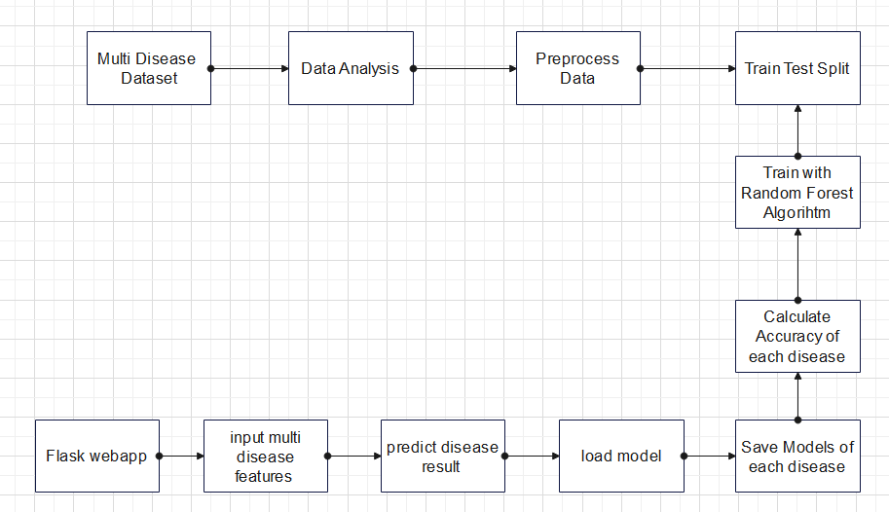
Architecture Diagram

Slide 9
Software Requirements
Operating system : Windows XP/7/10.
Coding Language : Python
Tool : Anaconda
Interface : OPENCV
Dataset : heart, diabetic, liver, kidney, malaria, pnemonia

Slide 10
Hardware Requirements
System : Intel(R) Core(TM) i3-7020U CPU @ 2.30GHz
Hard Disk : 1 TB.
Input Devices : Keyboard, Mouse
Ram : 4 GB.

Slide 11
References
[1] Khurana, Sarthak . , Jain, Atishay ., Kataria ,Shikhar. ,Bhasin ,Kunal . , Arora ,Sunny . ,& Gupta , Dr.Akhilesh . Das. (2019). Disease Prediction System.International Research Journal Of Engineering and Technology , 6(5) , 5178-5184.
[2] Kamboj ,Mgha. (2020).Heart Disease Prediction with Machine Learning Approaches.International Journal Of Science and Research , 9(7) , 1454-1458.
[3]Ware,Miss.Sangya . , Rakesh,Mrs.Shanu. K.,&Choudhary,Mr.Bharat . (2020). Heart Attack Prediction By Using Machine Learning Techniques. International Journal Of Recent Technology and Engineering , 8(5), 1577- 1580. Turkish Journal of Computer and Mathematics 4023 Research Article Vol.12 No.6 (2021), 4013-4023
[4] Shirsath ,Shraddha.Subhash .,& Patil , Prof. Shubhangi . (2018).Disease Prediction Using Machine Learning over Big Data .International Journal Of Innovative Research in Science and Technology , 7(6), 6752-6757

